Slide 2
Bridging R Programming with Excel The Future of Data Modeling
Michael Charara | CDW | LinkedIn | Portfolio

Slide 3
GitHub Repo for Everything!
https://github.com/netdevmike/CDW-R-Programming-with-Excel.git

Slide 4

About me
Education
Bachelor in Biology with a Minor in Psychology
Bachelor in Computer Science - Software Engineering
Masters in Business Administration
Masters in Information Management Systems
Certifications
Master's Degree Certificates in Cybersecurity & Data Analytics
Multi-Cloud Certified Solutions Architect (GCP, AWS, AZURE), CCNA
HMS Certifications in Physiology, Immunology, Biochemistry, Genetics
Work Experience
Retail Chane manager- KFC, Pizza Hut, Tim Hortons
Research Assistant Autosomal Dominant Polycystic Kidney Diseases
Network Administrator - Focused on Automation
Cloud Marketplace Program Manager
Michael Charara
Program Manager

Slide 5

Agenda
Why R?
Learning Objectives
What is R?
What is R Studio?
Setup
Scripts

Slide 6

WHY R?
Functions and Features will take you FAR
Beginner Friendly
A few functions = a lot of power
Advanced libraries to make graphs
Alot of tutorials online

Slide 7



Who uses R?
Meta uses advanced tools like R programming for behavior analysis and social media analytics.
R is used in data management, data analytics, economic forecasting, and business-decision making at Google.
Amazon data scientists and analysts use R for statistics and machine learning to build analytics systems that can measure the marketing ROI average salaries for Amazon employees.

Slide 8
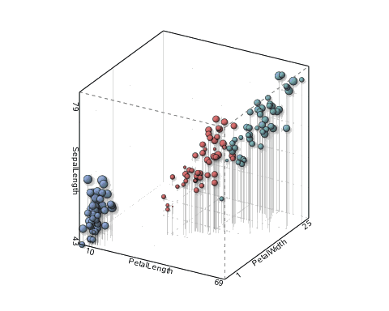
What is R?
R is a programming language for statistical computing and graphics.
The most popular statistical software in circulation today
Source: How Companies Use R to Compete in a Data-Driven World, data-informed.com
Download R! - https://cran.r-project.org/

Slide 9

What is R Studio?
IDE – Integrated Development Environment
Adds additional functionality e.g. git, shiny projects, markdown templates
R studio is the most popular IDE for R
Not needed to execute R
R Studio sits atop the installed R version.
Download R Studio! - https://posit.co/download/rstudio-desktop/

Slide 10
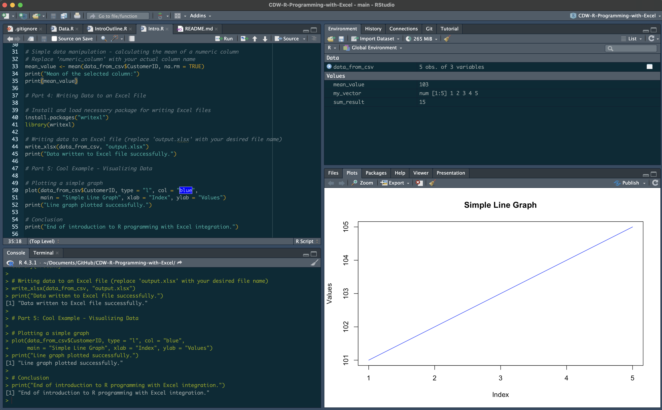
R Studio has four main panes
Code Editor
Environment
Console
Plot & Files

Slide 11

R workflow
Let’s eat an apple for breakfast. Where is the fruit?
If a “local” file define the path to the file
setwd(‘fridge/shelf/fruits’)
OR
From a URL
csvFile <- ‘https://raw.githubusercontent.com/netdevmike/CDW-R-Programming-with-Excel/main/data/Customer_Data.csv?token=GHSAT0AAAAAACD2NM5HJUAQUG7JJJ7FN7AKZL2SGNA’
The item of interest needs to be in the “working directory”

Slide 12


R uses functions, libraries and objects
Found the fruit shelf! What tools do I need?
#setwd(“fridge/shelf/fruits”)
library(peel)
library(knife)
library(readr)
Change R into a breakfast-preparing machine with specialized libraries.

Slide 13
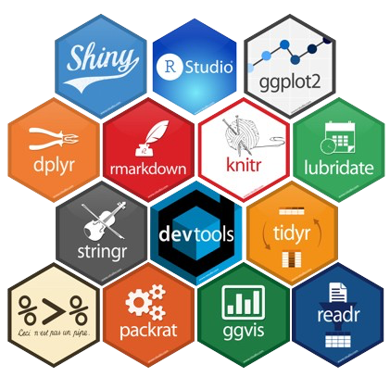
Lets build our toolbox (Libraries)
Before loading a library use
install.packages(“name of package”).
You only need to do this once per environment
But, you will need to repeat it w/each new environment!

Slide 14
R uses functions, libraries and objects
library(peel)
library(knife)
library(readr)
Now R is a cutting & peeling machine, let’s pick our fruit.
Fridge/shelf/fruits -> apple, banana, pear
setwd(‘fridge/shelf/fruits’)
apple <- readr(“Apple.”)
peelApple <- peel(apple)
cutApple <- knife(peelApple)

Slide 15
LETS CODE!

